Slide 1
Workshop
Long-term Impacts of Health and Development Interventions in Matlab
Dr. A. Razzaque, ICDDR,B
Dr. Jane Menken, University of Colorado Boulder
11 June 2012

Slide 2
Collaborators
ICDDR,B
  Dr. A. Razzaque
  Dr. Abbas Bhuiya
  Dr. Jena Hamadani
University of Colorado Boulder
  Dr. Jane Menken - Dr. Nobuko Mizoguchi
  Dr. Randall Kuhn - Dr. Tania Barham
  Dr. Elisabeth Root - Dr. Jill Williams

Slide 3
Question
Do maternal and child health and family planning/reproductive health programs have long-term impacts on economic and social empowerment of women?

Slide 4
Project
Address this question through analysis of one specific program - the Matlab Maternal and Child Health and Family Planning Program begun in 1978
Approach
  Matlab is the only place in the world where data needed for long-term analysis is available
  Link existing ICDDR,B data 1974-2012
  Collect new data: Matlab Health and Socioeconomic Survey 2

Slide 5
Focus of Workshop
Your advice in formulating analyses of women’s economic and social empowerment
Analyses need to be responsive to interests and needs of, in addition to researchers,
  policy makers
  program implementers, whether government or NGO’s
  donors who contributed funding for the original programs
We ask your advice in formulating these analyses

Slide 6
Outline of presentation
1. Description of MCH-FP program
2. Data – available and to be collected
3. Intermediate results – 1996
4. Long-term outcomes to be considered
5. Possible pathways through which MCH-FP may influence economic and social empowerment
6. Suggested topics for discussion

Slide 7
The Matlab Maternal and Child Health and Family Planning Program
Begun in 1977 in ~ ½ the area covered by the Matlab Health and Demographic Surveillance System – the MCH-FP area
Comparable services were not available in the other ½ - the Government Area – until about 1988

Slide 8
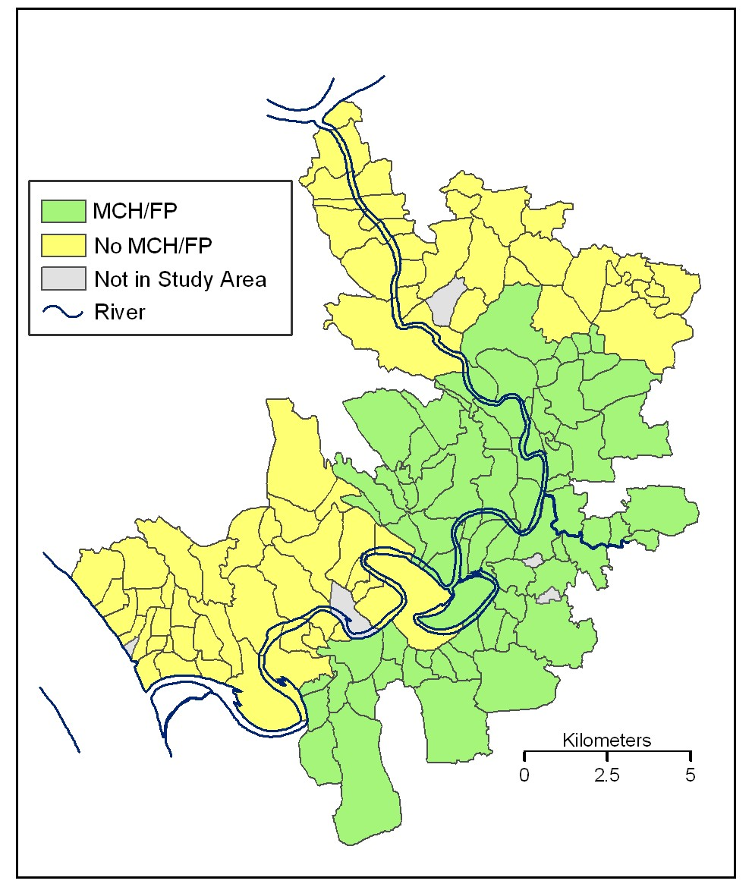
Matlab Maternal and Child Health and Family Planning Program: 1977-

Slide 9
MCH-FP Program Interventions
1977
1982
1985
1986
1988
1989
Family planning/
Oral rehydration
Measles
(1/2 MCH-FP area)
Measles
(1/2 MCH-FP
area)
DPT Polio
Vitamin A
Nutrition
Acute
Respiratory Care
Dysenteric Diarrhea Treatment/
Vaccination
in comparison area
All vaccination given to age 5 and under
Interventions provided in home by community health worker
Minimal government health care in comparison area until after 1988, so there were crucial differences by area 1977-1988
MCH-FP Program continues today

Slide 10
The Matlab Maternal and Child Health and Family Planning Program
Experimental period 1977-1988
  During this period, women and children in the MCH-FP area were eligible for the services provided by ICDDR,B while those in the Government Area were not
  There is, therefore, a true experiment

Slide 11
The Matlab Maternal and Child Health and Family Planning Program
Two generations of interest – defined by age in 2012
  Adults (35-73): reproductive age during experimental period
  Children (22-34): mothers in MCH-FP area eligible for MH-FP; some children eligible for child health interventions during experimental period

Slide 12
The Matlab Maternal and Child Health and Family Planning Program
    Adults (35-73 in 2012)
      Did the MCH-FP Program lead to improved economic and social empowerment over the long term?
Children (22-34 in 2012)
  Does the program have effects that carry over into adulthood?
  Specifically, do children, especially girls, who were eligible for the child health programs have better economic and social empowerment?

Slide 13
Additional Interventions
The Meghna-Dhonnagoda Irrigation Project (Embankment), began 1987
Bangladesh Rural Advancement Committee (BRAC) microcredit and other programs, began 1992

Slide 14
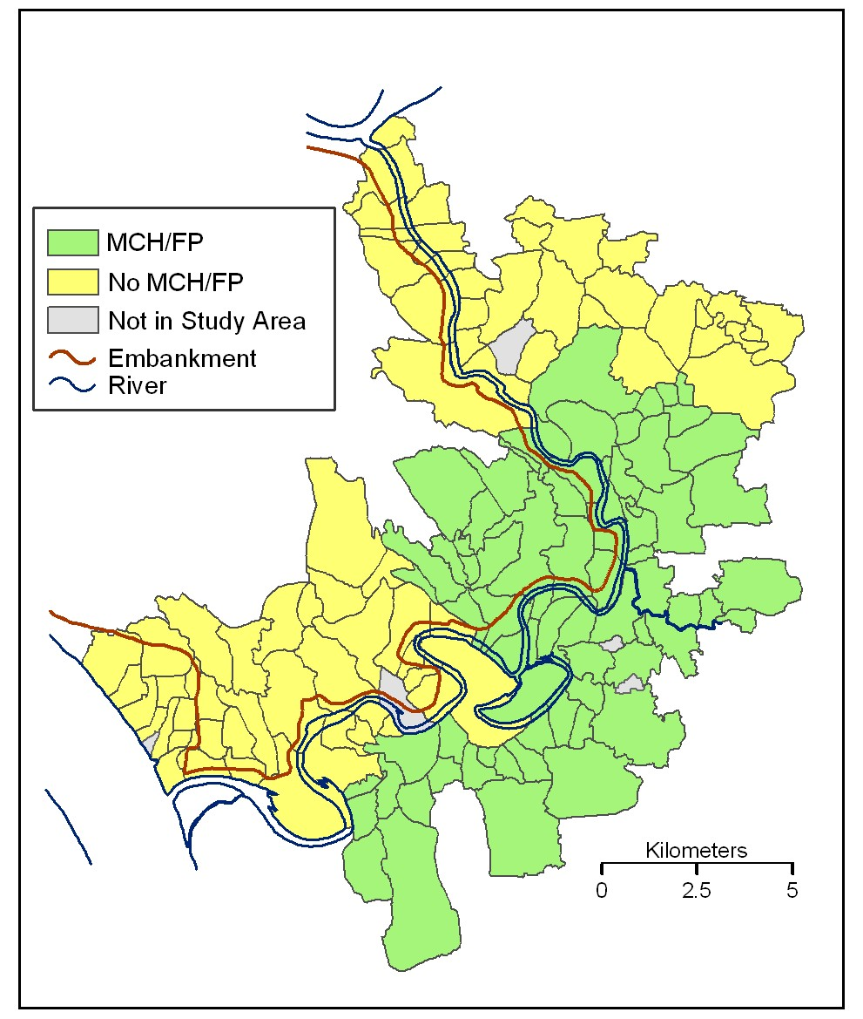
Embankment to protect from flooding completed 1987, repaired 1989

Slide 15
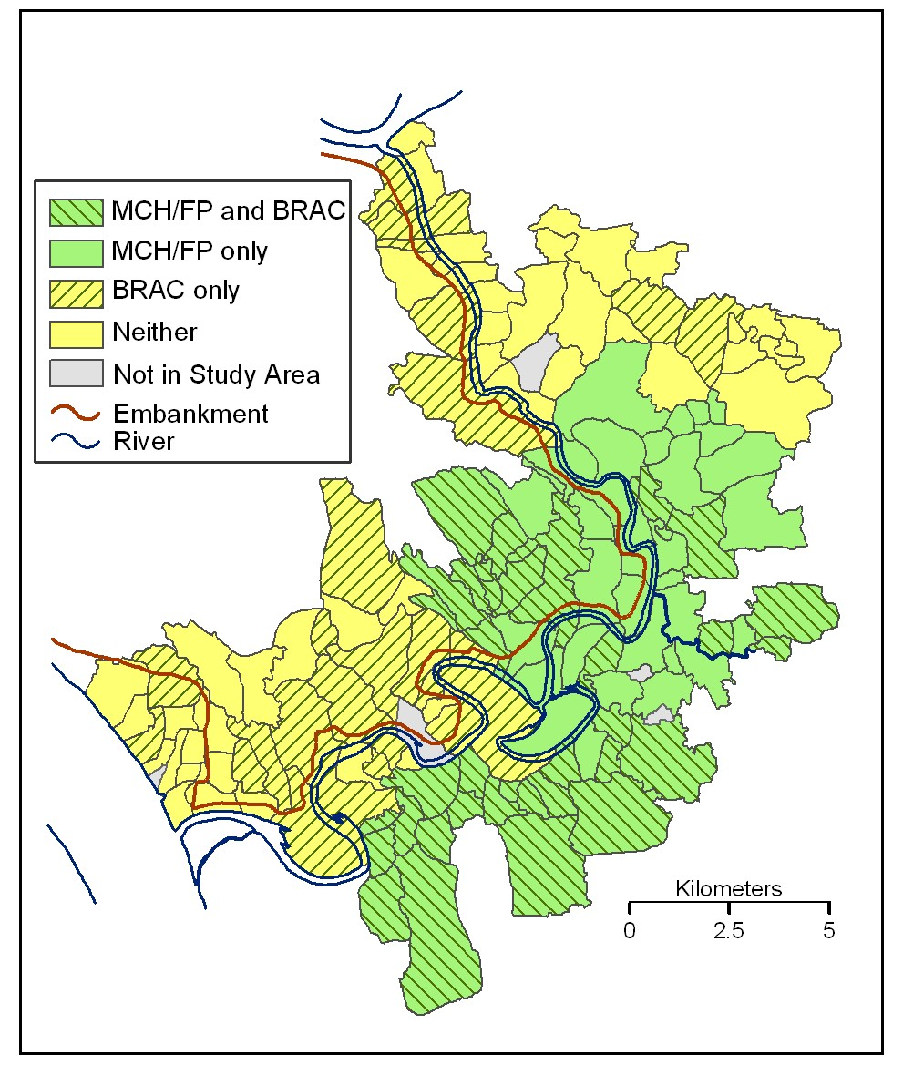
BRAC Microcredit and other programs began 1992

Slide 16
Health Context
Women had lower life expectancy than men
By stages of life:
  No sex difference in infancy
  Higher mortality for girls aged 1-4 than boys
  Slightly lower survival from age 10-50 (roughly the reproductive ages) and about the same life expectancy at age 10 for women and men

Slide 17
Life Expectancy by Sex
Matlab: 1967-1985

Slide 18
Mortality Rate by Sex
Children 1-4
Matlab: 1974-1985

Slide 19
Among children aged 1-4 in 1978, girls more likely than boys to be severely malnourished
Source: Chen et al. 1981

Slide 20
Rapid MCH-FP Program uptake
Contraceptive Prevalence Rate (CPR)
Measles Vaccination Rate (MVR)

Slide 21
Matlab: TFR (per woman)
Notes:
Fertility declined rapidly in Treatment area – followed in government area

Slide 22
Life expectancy in Matlab
Life expectancy in Matlab increased and women not only caught up with men but crossed over – so that women have higher life expectancy in both the MCH-FP area (upper panel) and the comparison area (lower panel)

Slide 23
Child mortality
Child mortality declined dramatically but did so more quickly in the
MCH-FP area (upper panel)
There is no mortality difference between boys and girls

Slide 24
Medium-term
Effects of Family Planning Program on Women - 1996
Women in MCH-FP area had an average of 1.5 fewer children than in comparison area
The gap in surviving children was much less – 0.8 - due to increased survival in MCH-FP area
Women in MCH-FP area were likely to have preventive care – for themselves and their children (e.g. prenatal care, child vaccination)
        (Schultz and Joshi)

Slide 25
Medium-term Effects of MCH-FP Program on Children
Vaccination rate 20-30 percentage points higher
Less malnutrition (wasting and stunting) in MCH-FP area but girls still more likely to be malnourished
Schooling increased in both areas
  Boys’ schooling higher in MCH-FP area
  No difference for girls - Not surprising because of the strong education programs directed toward girls

Slide 26
Children aged 1-4: more had normal weight, but girls still more likely than boys to be severely malnourished
1978
1996
Source: Chen et al. 1981 & 1996 MHSS

Slide 27
Cognitive function
6-15 % increase in cognitive functioning as measured by the Mini Mental State Exam (MMSE) for those who, as children, were eligible for the highest intensity health interventions
Effect over and above increases in level of education
(Barham 2011)

Slide 28
Mean MMSE by 1997 Age

Slide 29
Unexpected effect
Two separate studies found that families in MCH-FP area gave higher dowries for their daughters
The argument given is that women have a greater stake in wanting to use family planning – and a higher dowry is needed to persuade men to participate
        Arunachalam and Naidu 2008
        Peters 2008
  Comment at workshop – RUBBISH!

Slide 30
Unexpected effect
Women in MCH-FP area 33% less likely to be able to make large purchases without permission
One interpretation: MCH-FP desirable and women and their parental families bargain for it through higher dowries and less empowerment

Slide 31
Intended effects of embankment
Crops:
  increased number of growing seasons
  Irrigation and protection led to Increased rice crop yields in seasons previously flood-affected
Economic
  Increased income
  Increased assets, including land value
  Economic risk effect – Flood control reduces risks associated with planting
  (Mobarak, Kuhn, Peters unpublished 2009)

Slide 32
Health effects of embankment
Moderate effects on mortality
  (Myaux et al 1997)
Lower death rate from diarrhoeal diseases among adults
Lower death rates from infectious diseases for adult men
(Mobarak, Kuhn, Peters 2009)

Slide 33
Marriage Market Effects
Little effect on age at marriage
Protected husbands command larger dowries after embankment creation
People from protected households become 10% more likely to marry into wealthy families relative to the unprotected
    Effects confirmed in a triple difference (pre/post un/protected by occupation)
Slower fertility decline in protected households

Slide 34
Consanguineous marriage
33% larger drop at the mean (nearly 3 percentage point decrease) in consanguineous marriages among the protected
In the household fixed effect DID regression,
the same family is 40% less likely to marry a younger child to a biological relative after they are protected by embankment, than their older child who married prior to the embankment construction

Slide 35
Effects of Microcredit Programs
BRAC programs began in Matlab only in 1992, so there have been no analyses that followed their effects except over the very short term
In other parts of Bangladesh, analyses have shown that credit given to women rather than men is more likely to be used for household expenditure and for children’s needs – including nutrition and education

Slide 36
DATA: ICDDR,B Unique Information
Matlab Health and Demographic Surveillance System (MHDSS) began over 40 years ago
  Households visited monthly for many years; now every 3 months
  Register of all vital events, 1966-
    Births, deaths, marriages, divorces, in- and out-migration episodes lasting 6 months or more
  Censuses in 1974, 1982, 1993, 1996
  Allows precise estimation of ages
  Matlab Health & Socieconomic Survey 1, 1997
  Permits effective sample tracking, followup

Slide 37
MHSS2 Sample
Fieldwork begins September 2012
Follows all members of 1996 sample households and their descendants
  Face-to-face interview in Bangladesh
  Telephone interview (brief) with international migrants
Links to all Matlab data going back to 1974
Data will be available to researchers

Slide 38
Matlab Health & Socioeconomic Survey 2
Data
  Household composition
  Socioeconomic status
  Health – both reported and observed
  Cognitive tests
  Gender equitable scale

Slide 39
Economic outcomes to be considered
labor force participation, including labor outmigration
use and repayment of micro-credit loans
cash savings and bank accounts in their names
household income and poverty as measured by per capita household expenditure/consumption
household consumption of women’s self-care products

Slide 40
Social empowerment outcomes
decision-making power over household expenditures
mobility outside the household for health, economic or social purposes
own, husband’s, and their children’s perceptions of women’s status, as assessed using a Gender Equivalence Scale
participation in community organizations and decision-making
knowledge of or participation in local and national political events

Slide 41
Pathways/Mechanisms
Health
Cognition
Education
Social Networks
Family size/sibling competition
Composition of sibling set
All of these early characteristics may affect
  Marriage
  Migration

Slide 42
To summarize
Do the programs increase women’s empowerment? decrease domestic violence?
Do children who were eligible for the child health programs have greater human capital and better economic outcomes?
Do program effects on children carry over to adulthood
Are there significant intergenerational effects – for grandparents, grandchildren?

Slide 43
Breakout Questions
1 Based on your work in this area, are we on the right track? Are the outcomes listed plausible for the effect of maternal and child health and family planning programs?
2. What else should we be looking at?
3. Similarly, for mechanisms, are we on the right track? Are these the pathways/mechanisms you have observed?
4. Are there others that you would like to see included?
5. For your work, research/govt/ngo, what information would be helpful to advance your work?
6. For the future, what kinds of communication of research would be appropriate? Forum? Policy briefs?

Slide 44
Breakout Questions
1 Based on your work in this area, are we on the right track? Are the outcomes listed plausible for the effect of maternal and child health and family planning programs?
2. What else should we be looking at?
3. Similarly, for mechanisms, are we on the right track? Are these the pathways/mechanisms you have observed?

Slide 45
Breakout Questions
4. Are there others that you would like to see included?
5. For your work, research/govt/ngo, what information would be helpful to advance your work?
6. For the future, what kinds of communication of research would be appropriate? Forum? Policy briefs?

Slide 46
Lessons learned
Few studies of the effects of intervention programs have been long-term – and longer-term effects may be quite different
Expected and unexpected outcomes need to be traced out
The theories used to design interventions may well be flawed – or overcome by external events, so that wide ranging data collection is essential
  Education programs
  Arsenic

Slide 47
THANK YOU!

Slide 48
Additional slides not used in presentation

Slide 49
Arsenic in
Tube-wells

Slide 50
Mortality of children age 1-4 related to sex composition of older sibling set
Child survival in Matlab for children born 1982-83
  Girls with at least one older sister had mortality odds double those of children at lowest risk of dying
  Boys with at least 2 older brothers had mortality odds 45% higher than those of children at lowest risk
  Muhuri and Menken (1997)

Slide 51
Relative odds of dying by family composition and gender:
Matlab children 1-4 born 1982-83

Slide 52
“In a situation of scarce resources, parents may be forced to allocate … resources… differentially, and a system of preferential treatment may develop…. resources that affect child survival appear to go to one girl and two boys in the family. The preference pattern appears invariant over all other variables [included]”
  (Muhuri and Menken 1997)

Slide 53
These results also suggest that there was, in Matlab, a deep-rooted set of preferences about children that contradicted notions of desire for large numbers - of either sons or daughters. These preferences may have fostered acceptance of family planning services when they were offered in a way that was acceptable to families in rural Bangladesh. (Muhuri and Menken 1997)

Slide 54

Embankment
65 km earthen barrier protects villages on NW side of Dhonnagoda River from seasonal flooding
Includes 220 km of irrigation canal, 125 km of drainage channel
“Natural experiment” in that households were not formally assigned to treatment and control

Slide 55
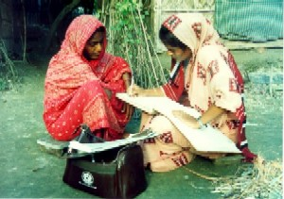
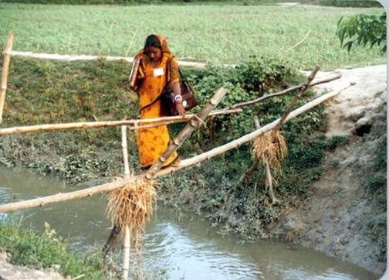
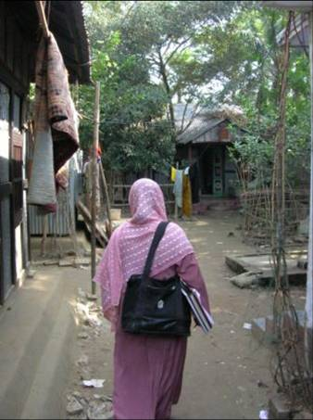
CHWs at work

Slide 56
Key MCH/FP Services
Mothers
  In-home family planning services
  Antenatal care
  Tetanus toxoid
Children
  Immunization (DPT, measles, polio, BCG)
  Diarrhoeal outreach (incl. oral rehydration)
  Vitamin A

Slide 57
Women’s survival in relation to their childbearing
20-year followup study 1976-1996 of DNFS women (comparison area) through the HDSS found survival
⇩ Decreased with age – as expected
⇧ Increased with education
⇧ Increased with Body Mass Index
    BMI = weight/ (height)²
    Measured in 1976

Slide 58
Women’s survival in relation to their childbearing
Women had increased risk of dying for a much longer time after a birth than previously thought - ~2-3 YEARS
  No other relationship with parity
  No relationship with rapidity of childbearing
Effect of reducing live births from 7 to 3
  Of women who reached age 15, 25% fewer would die before age 50

Slide 59
Relative odds of dying in year, 1976-96:
Matlab DNFS women under 50
Recent birth: birth in this or previous 2 years

Slide 60
Acting on Preferences
Relative Odds of Progressing
Parity 3 to 4: BDHS & MHSS
After 1994, women who had 2 boys and 1 girl had significantly lower odds of progressing to parity 4

Slide 61
Relative Odds of Progressing
Parity 2 to 3: BDHS & MHSS
After 1994, women who had no sons had significantly higher odds of progressing to parity 3 compared to women at least one son

Slide 62
MCH-FP Eligibility by Age in 1996 MHSS
Age in MHSS | Year Born | Eligibility
25+ | Pre - 1972 | Not Eligible for MCH-FP (baseline group)
20-24 | 1972-1976 | Not Eligible for MCH-FP but potentially affect though sibling competition
15-19 | 1977-1981 | FP and Non-intensive health treatment: Measles vacc. after recommended age
8-14 | 1982-1988 | FP and Intensive health treatment: All vaccines and some received other child health interventions
6-7 | 1989-1990 | Some interventions now available in comparison area from government
Note: breaking 8-14 group into 8-11 and 12-14 year olds gives same results
Notes:
Break-down in age group of 8-14 year olds to reflect adolescents and those that received only on-time vaccination for all vaccinations.
See effect on those on received mainly the FP program as compared to those who received FP and child health interventions

Slide 63
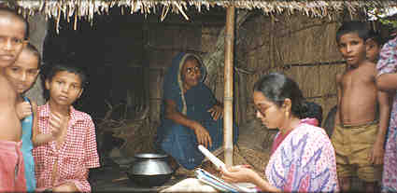
Interview in progress
Privacy????

